Slide 1
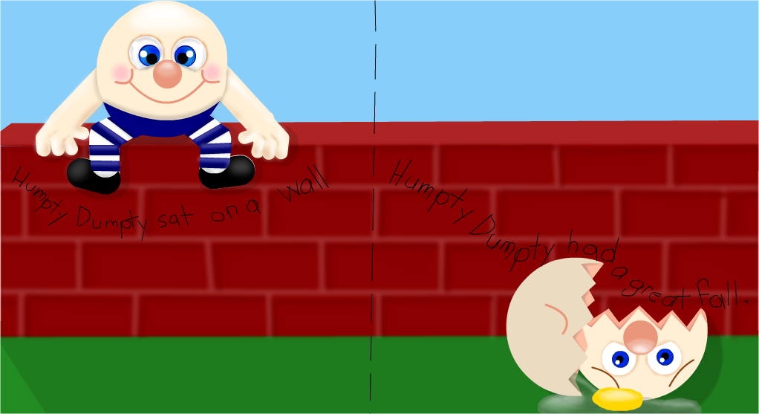
Nursery Rhyme Fun

Slide 2
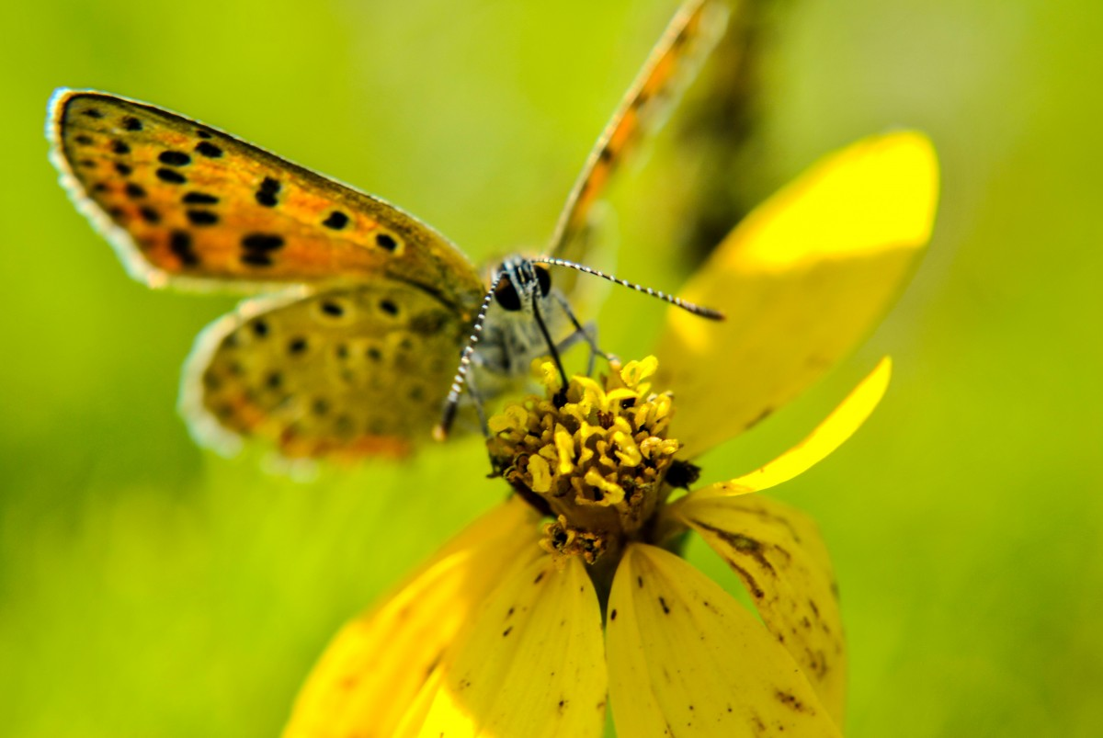
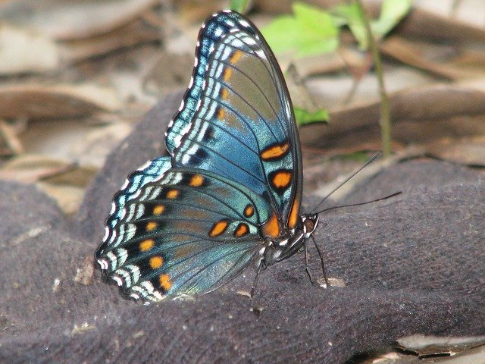
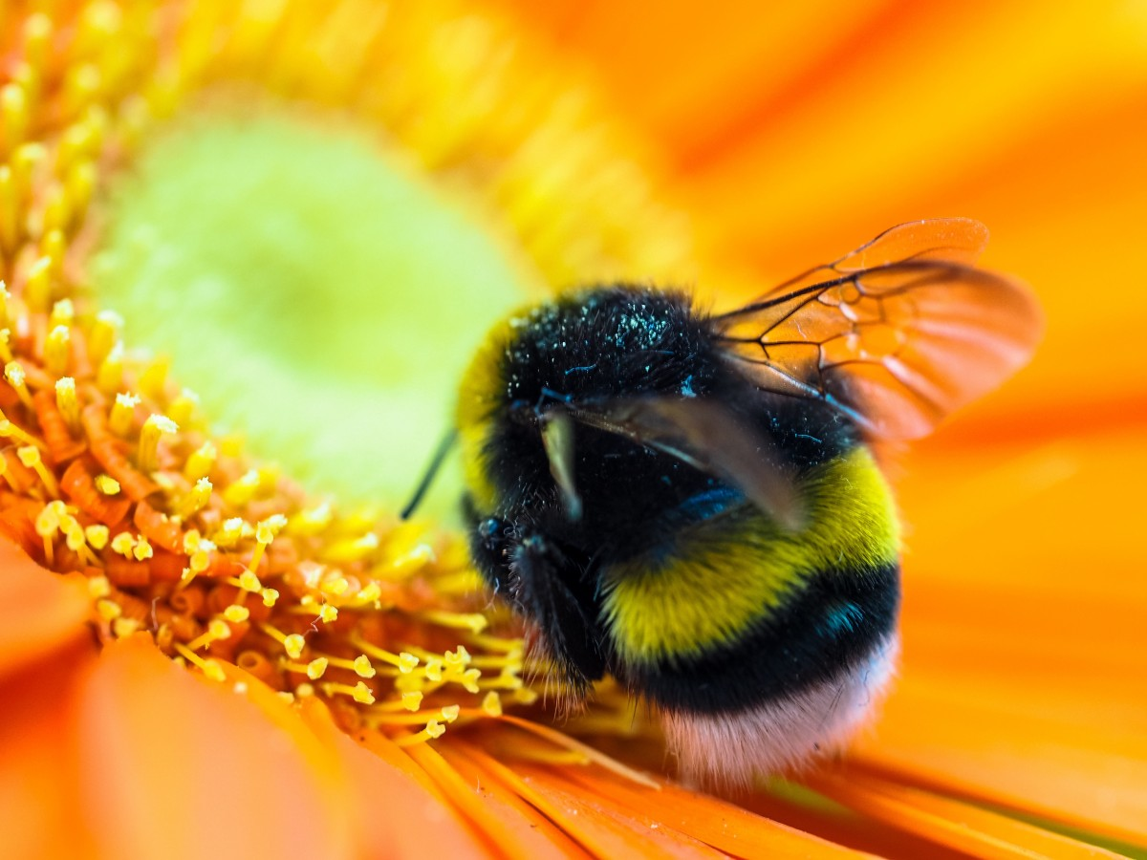
Can you name some of the bugs you might see in the Spring?

Slide 3
Do you know any nursery rhymes?
Do you know the muffin man who lives on Drury Lane?
https://www.youtube.com/watch?v=f530knS807Y
Infants: Allow the infant to hear the song and watch his/her expressions.
Toddlers: Count the number of muffins the muffin man has..
What is your favorite type of muffin?

Slide 4
Ba Ba Black Sheep
https://www.youtube.com/watch?v=bvHoAxlh2MQ
Infants: Sing the song with excitement. This is a fun song. Make sure your infant is looking at your mouth as your sing the song. This helps the child to form his/her mouth for early stages of speaking.
Toddlers: Talk about the colors of the sheep. Point out the color black, and relate it to other things in the house that are black.

Slide 5
Humpty Dumpty
https://www.youtube.com/watch?v=nrv495corBc
Infants: Sit on the floor as you sing this song. Pretend to fall off a wall.
Toddlers: Have the child sing, and repeat the words after you. Point to the words as you sing the song.

Slide 6
Family Activity

Slide 7
Let’s Paint with Cotton
Infants: Use a cotton ball or a q-tip. Rub the cotton ball or q-tip on the child, and tell them how soft it is.
Toddlers: Use a cotton ball or a q-tip, and allow the child to paint a picture.
If you have some skittles or any type of colored candy at home, allow the child to sort the different colors in a cup.
Add water to each cup and let it sit for forty-five minutes. You will see the candy dissolve in the water.
Use the cotton ball or q-tip to dip in the cup and paint. Have Fun!

Slide 8
Sock Puppets
Create a sock puppet using a sock.
Get creative and give the puppet some eyes, a nose, and even some hair. When you are playing the nursery rhymes use the puppet for a fun prop.

Slide 9
Potty Training Tips
https://www.youtube.com/watch?v=hVyTTCnLH3g
Watch this interactive video with Elmo and his friends on potty training.

Slide 10
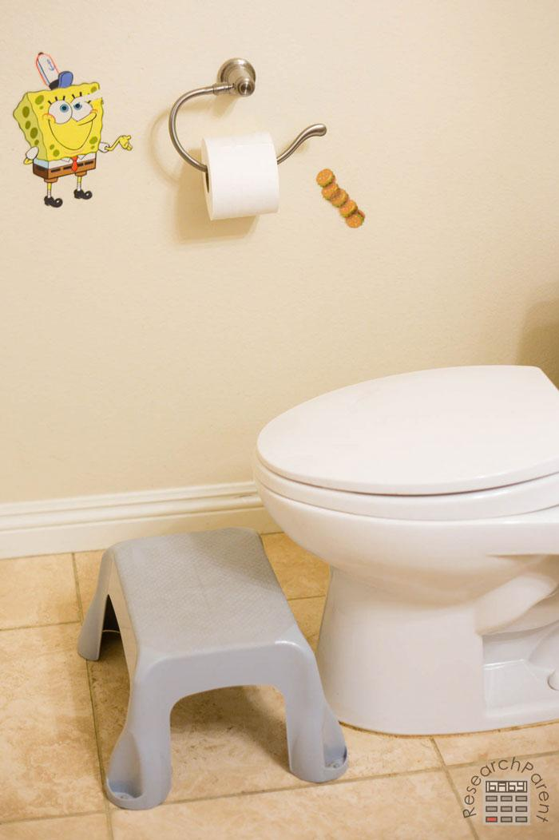
5 Tips for Potty Training
1. Be clear and consistent.
2. Establish a routine.
This Photo by Unknown Author is licensed under CC BY-SA

Slide 11
Tips for Potty Training
3. Help them relax.
Reward the goals that are achieved.

Slide 12
5. Remain positive and calm.

Slide 13
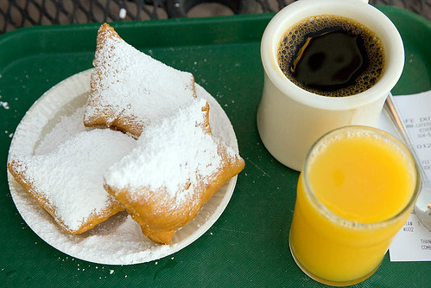
Table Talk
Mom/Dad is everything ok?
Let’s continue to potty train. Use the tips provided in this session.
Keep your child on a regular routine. For example: Put them to bed by 8 pm and wake them up by 7 am. This will help when they return to school.
Is there anything the program can help you with?

Slide 14
Additional Resources
https://www.youtube.com/watch?v=slQpZyaciIg
Elmo’s Song
https://www.youtube.com/watch?v=_UR-l3QI2nE
Alphabet songs with sounds.

Slide 15
References
YouTube:
https://www.youtube.com/watch?v=slQpZyaciIg – Alphabet Fun
https://www.youtube.com/watch?v=_UR-l3QI2nE - Elmo Song
https://www.youtube.com/watch?v=hVyTTCnLH3g – Elmo Potty Training
https://www.youtube.com/watch?v=nrv495corBc – Humpty Dumpty
https://www.youtube.com/watch?v=bvHoAxlh2MQ – Ba Ba Black Sheep
https://www.youtube.com/watch?v=f530knS807Y – Muffin Man

